Slide 1
CHAPTER ONE
INTRODUCTION TO SOFTWARE TESTING
Software Testing and Quality Assurance

Slide 2
Introduction to Software Testing
“When we are testing something, we are checking whether it is OK “
Software testing is a process used to identify software’s correctness by considering all its attributes (Reliability, Scalability, Portability, Reusability, and Usability) and evaluating the execution of software components to find the software bugs or errors or defects.
In simple words, software testing is an activity to check that the software system is defect-free.
Testing is necessary because we all make mistakes, some of those mistakes are unimportant, but some of them are expensive or dangerous. We need to check everything and anything we produce because things can always go wrong – humans make mistakes all the time.
Software bugs can potentially cause monetary and even human loss.
It is important to ensure that the application does not result in any failures.

Slide 3
What is Testing?
Testing is the process of evaluating a system or its component(s) with the intent to find whether it satisfies the specified requirements or not.
In simple words, testing is executing a system in order to identify any gaps, errors, or missing requirements in contrary to the actual requirements.
According to ANSI/IEEE 1059 standard, Testing can be defined as - A process of analyzing a software item to detect the differences between existing and required conditions (that is defects/errors/bugs) and to evaluate the features of the software item.

Slide 4
Who does Testing?
It depends on the process and the associated stakeholders of the project(s). In the IT industry, large companies have a team with responsibilities to evaluate the developed software in context of the given requirements. Moreover, developers also conduct testing which is called Unit Testing. In most cases, the following professionals are involved in testing a system within their respective capacities −
  Software Tester
  Software Developer
  Project Lead/Manager
  End User
Different companies have different designations for people who test the software on the basis of their experience and knowledge such as Software Tester, Software Quality Assurance Engineer, QA Analyst, etc.
It is not possible to test the software at any time during its cycle. The next two sections state when testing should be started and when to end it during the SDLC.

Slide 5
When to Start Testing?
An early start to testing reduces the cost and time to rework and produce error-free software that is delivered to the client. However, in the Software Development Life Cycle (SDLC), testing can be started from the Requirements Gathering phase and continued till the deployment of the software.
It also depends on the development model that is being used. For example, in the Waterfall model, formal testing is conducted in the testing phase; but in the incremental model, testing is performed at the end of every increment/iteration, and the whole application is tested at the end.
Testing is done in different forms at every phase of SDLC −
  During the requirement gathering phase, the analysis and verification of requirements are also considered as testing.
  Reviewing the design in the design phase with the intent to improve the design is also considered as testing.
  Testing performed by a developer on completion of the code is also categorized as testing.

Slide 6
When to Stop Testing?
It is difficult to determine when to stop testing, as testing is a never-ending process and no one can claim that a software is 100% tested. The following aspects are to be considered for stopping the testing process −
  Testing Deadlines
  Completion of test case execution
  Completion of functional and code coverage to a certain point
  Bug rate falls below a certain level and no high-priority bugs are identified
  Management decision

Slide 7
How Much Should We Test?
The question of "how much" to test is a crucial one. Testing everything is impossible, and prioritizing testing efforts is essential. The ideal balance is achieved by targeting areas with a higher risk of bugs and potential impact. This involves understanding the critical functionalities, user flows, and potential failure points of the software.
Risk Analysis: Identify areas of the software with a higher risk of bugs and potential impact, based on factors like complexity, criticality, and user interactions
Prioritization: Prioritize testing efforts towards the most critical areas identified in the risk analysis, ensuring adequate coverage of core functionalities.
Testing Coverage: Establish realistic testing coverage targets based on the identified risks and priorities, ensuring that critical areas are adequately tested.
Continuous Testing: Adopt a continuous testing approach, performing regular testing throughout the development lifecycle to catch bugs early and prevent them from accumulating.

Slide 8
Test Cases
A Test Case is a documented set of conditions or actions used to verify that a software application functions as expected. It outlines inputs, execution steps, and expected outcomes.
Each test case typically includes a title, description, test steps, and expected results.
In its most basic form, a test case is a simple pair of <input, expected outcome>.
In stateless systems, where the outcome depends solely on the current input, test cases are very simple in structure.
If a program under test is expected to compute the square root of nonnegative numbers, then examples of test cases can be:
  TC1: <0, 0>
  TC2: <25, 5>
  TC3: <40, 6.324553>

Slide 9
Selection of Good Test Cases
Test cases are specific scenarios designed to test different aspects of the software. Selecting good test cases is crucial for effective testing. These cases should target key functionalities, boundary conditions, error handling, and potential user scenarios, providing comprehensive coverage of the software's features.
Functional Testing: Verify that the software meets its intended functionality. For example, test if a login feature correctly authenticates users.
Performance Testing: Ensure that the software performs adequately under different load conditions. For example, test how the website responds with a large number of concurrent users.
Security Testing: Identify potential security vulnerabilities in the software. For example, test if sensitive data is adequately protected.
Usability Testing: Evaluate the user experience and ensure the software is easy to use and understand. For example, test if users can easily navigate and complete tasks.

Slide 10
Measurement of Testing
Measuring the effectiveness of testing is essential for improving the process. This involves tracking various metrics like defect density, test coverage, and time to resolution. These metrics provide insights into the quality of the software, the efficiency of the testing process, and areas for improvement.
Defect Density | Number of bugs found per line of code or unit of functionality.
Test Coverage | Percentage of code or functionality covered by test cases.
Time to Resolution | Average time taken to fix bugs and implement changes.
Test Automation Rate | Percentage of tests that are automated, reducing manual effort and increasing efficiency.
Traceability Matrix | associate test cases with requirements and measure coverage
Test Case Design Yield (TCDY) | metric to measure test case design effectiveness

Slide 11
Software Testing Life Cycle (STLC)
The procedure of software testing is also known as STLC (Software Testing Life Cycle) which includes phases of the testing process. The testing process is executed in a well-planned and systematic manner. All activities are done to improve the quality of the software product.
Let's see, the different steps of STLC.
Software testing life cycle contains the following steps:
  Requirement Analysis
  Test Plan Creation
  Environment setup
  Test case Execution
  Defect Logging
  Test Cycle Closure
  We will discuss each one of these steps in detail in the coming sections.

Slide 12
Characteristics of STLC
STLC characteristics define the scope of testing and its importance as a part of SDLC. Here are some of them:
STLC is a fundamental section of SDLC, but it only consists of testing phases.
The phases of STLC start soon after requirement documents are defined.
STLC follows a series of steps in a sequential manner to yield quality software that functions as per the requirement document.
In STLC, before starting any phase, you will have to analyze and define the scope of testing, the entry and exit criteria, and the test cases. All this helps to decrease the test cycle time and enhance product quality. And after the development phase is complete, the testing team can begin the execution using the test cases.

Slide 13
Importance of Software Testing Life Cycle
Quality and dependability of software products are ensured by the Software Testing Life Cycle (STLC).
Early Detection of Defects: The STLC initiative takes place at an early stage of software development. This means that bugs can be caught and eliminated before they grow into bigger issues later down the line. This approach saves time and resources as it deals with problems when they are less costly to address.
Improved Quality: When all components of the software are tested to ensure they meets the required standards including performance and security – it helps improve quality.
Risk management: Risk assessment and mitigation strategies are part of STLC. When potential risks are identified and worked on during the testing phase, this helps reduce the occurrences of software failure or unexpected behavior in production.

Slide 14
Importance of Software Testing Life Cycle..
Clear Testing Goals: For each phase of STLC, there are particular deliverables and goals— like the test plans, test cases, and test reports. This clear understanding makes sure that the tests are done in an organized way which helps to deliver better outcomes from the testing process.
Cost Efficiency: Although the adoption of STLC is time and resource consuming at the outset, it eventually leads to curtailment of expenses related to defects that surface post release. It costs a lot less to address issues if they are discovered and dealt with during the development phase than after the software has been rolled out.
Customer Satisfaction: When properly tested software is delivered, it not only does what the customer expects in terms of functionality, reliability, and performance but also wows user satisfaction, leading to trust by end users in the software system.
Compliance and Standards: If these are met by the software, it adheres to STLC, thus making sure that the software is compliant with required regulatory standards and guidelines. This can be very important in industries such as healthcare, finance, or aerospace where the issue of reliability and safety of software is crucial.
Continuous Improvement: STLC helps make things better by giving feedback at different points. This allows us to learn from testing and use that to improve development processes, tools, and frameworks

Slide 15
What is the Role of Software Testing Life Cycle?
The role of STLC is primarily to identify issues in the application as soon as possible and record it for developers to understand and resolve. For testers, STLC assists in the following:
  Fine-tuning the agile process, making it effective and efficient for cross-team communication
  Clearly defining the deadlines for project testing
  Properly documenting the goals and objectives of every project and following through consistently
  Ensuring and verifying that the objectives of all the phases are accurately met
  Testing each and every feature of the software before passing it for adding more features
  Analyzing the tasks that can be automated to improve the testing quality

Slide 16
Here are some of the common activities in STLC that you would have to execute:
  Analyzing all the requirements of the project
  Creating a document that measures the progress of the testing
  Identifying the testing types and techniques you need for the project at hand
  Determining which environment to test your application on
  Prioritizing the right tasks and understanding which of those can be automated
  Listing down the automation tools you need to run your STLC tests
Some of the popular automation tools you can use are Selenium, Cypress, and TestNG. All of these have different features and provide varying services to your testing needs. You can choose the one that complements your project.

Slide 17
Methodologies of Software Testing Life Cycle
There are a few main methodologies used in STLC:
  Waterfall Model
  Agile Model
  Scrum
  DevOps
  Iterative Model
  V Model (Verification and Validation model)

Slide 18
Verification & Validation
These two terms are very confusing for most people, who use them interchangeably. The following table highlights the differences between verification and validation.
Sr.No. | Verification | Validation
1 | Verification addresses the concern: "Are you building it right?" | Validation addresses the concern: "Are you building the right thing?"
2 | Ensures that the software system meets all the functionality. | Ensures that the functionalities meet the intended behavior.
3 | Verification takes place first and includes the checking for documentation, code, etc. | Validation occurs after verification and mainly involves the checking of the overall product.
4 | Done by developers. | Done by testers.
5 | It has static activities, as it includes collecting reviews, walkthroughs, and inspections to verify a software. | It has dynamic activities, as it includes executing the software against the requirements.
6 | It is an objective process and no subjective decision should be needed to verify a software. | It is a subjective process and involves subjective decisions on how well a software works.

Slide 19
Advantages and Best Practices of STLC
STLC makes sure to everything is tested thoroughly, catching problems early on to make sure the product is reliable and top quality. This saves money on fixing things later.
STLC also helps reduce risks and keep customers happy, which helps in improving and meeting industry standards.
Plus, STLC helps teams work together better and be more efficient.

Slide 20
What are Entry and Exit Criteria in STLC?
STLC must comply with entry and exit criteria to be termed as successful. Ideally, the QA team takes care of this point and only begins/completes the next STLC phase after both criteria are met. Both these criteria are defined for each phase of STLC.
Entry Criteria: Entry criteria for an STLC phase are to undertake all prerequisite conditions that must be met before testing starts. All the documents, with the necessary information regarding testing, should be available before initiating any of the STLC phases. For example, to begin with, creating test cases, you must have the user requirement document, a complete understanding of the application flow, and the test plan document. This is the entry criteria for developing and executing test cases.
Exit Criteria: Exit criteria are all the information/items that must be available and completed before concluding a phase. It includes all the actions, tasks, documents, and test elements that need to be over before marking the phase complete and moving on to the next one. One example of exit criteria can be verifying if the user requirements are proper and all the risk-associated areas of an application are thoroughly tested.

Slide 21
Testing Techniques
Black-Box Testing
White-Box Testing
In black-box testing, the tester designs test cases based on the software's functionality, without knowledge of its internal implementation.
Testers focus on inputs and outputs, ensuring that the software produces the expected outputs for various inputs.
Equivalence Partitioning: Dividing the input space into groups or partitions.
Boundary Value Analysis: Testing at the edges or boundaries of input ranges.
Decision Table Testing: Creating decision tables to represent complex business rules and conditions.
In white-box testing, the tester designs test cases based on the software's internal structure and implementation.
Testers have access to the source code and use it to guide their test case design, ensuring that different parts of the code are exercised during testing.
Statement Coverage: Designing tests to ensure that each statement in the code is executed at least once
Branch Coverage: Designing tests to ensure that each branch or decision point in the code is executed at least once.
Path Coverage: Designing tests to execute all possible paths through the code.

Slide 22
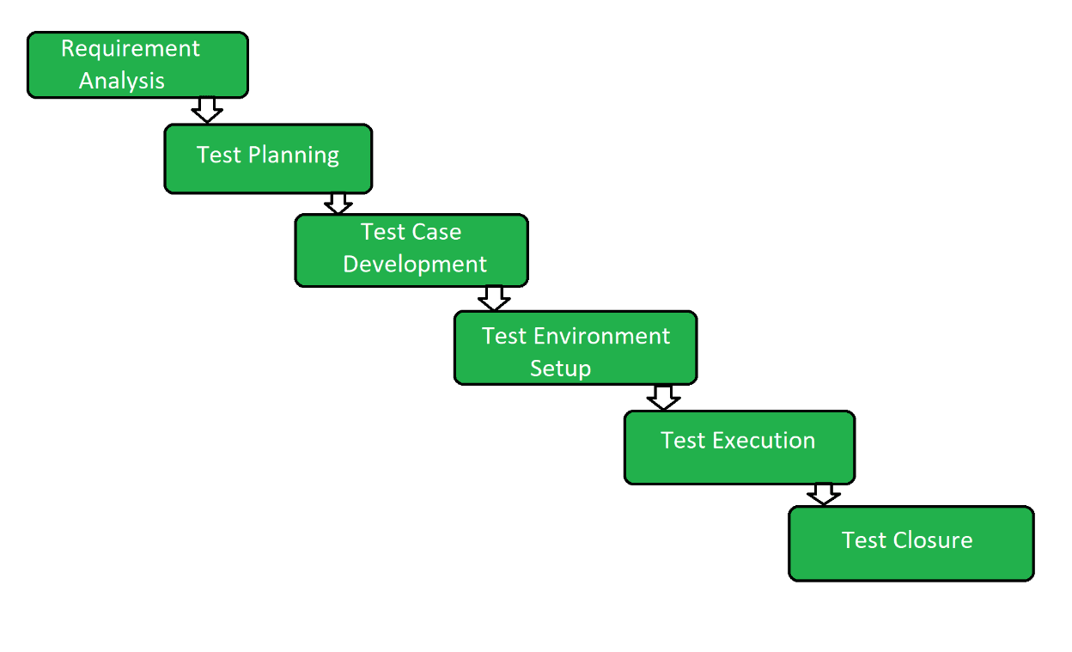
6 Phases of STLC Phases

Slide 23
STLC Phases
STLC consists of 6 phases where each has its entry-exit criteria and comes with associated activities and deliverables. Entry-exit criteria define when the phase starts and ends. Activities and deliverables define the actions taken within the phase and the results received. You can execute some of these phases together while others run more independently. These are the 6 phases of STLC:
Requirement Analysis : It is the first phase of STLC which deals with the QA team analyzing and understanding the requirement document to start the testing process with accurate information. In the Requirement analysis phase, the entry criteria are requirement documents, acceptance criteria, and understanding of the product architecture. The exit criteria for this phase are approved Requirements Traceability Matrix (RTM) and automation feasibility reports that evaluate if the tests can be automated. All of this ensures that the testing process starts with the right information and focuses on the important areas of the software

Slide 24
Test Planning : After determining the user requirements, the next phase of STLC is to plan the tests. It is a critical step of STLC where all the test plans are defined, and a detailed strategy is laid out for the project. It includes developing test steps, assigning roles and responsibilities, and choosing the right testing approach and automation tools, if any. The QA team also calculates the estimated cost and resources to begin the testing. The entry criteria for the test planning phase are approved Requirements Traceability Matrix (RTM) and automation feasibility reports. The exit criteria are approved test plans, automation scripts, and defining the cost analysis of the complete project.
Test Case Development/Design : After finishing the planning stage, this phase is designing and developing the test cases. In this step, the testing team creates the test steps with proper input, test execution conditions, and expected output for execution. For the test case design and development phase, the entry criteria are approved test plans, automation scripts, and defining the cost analysis of the complete project. The exit criteria are the approved test cases and automation scripts with the proper information for each test step.
Test Environment Setup : This phase includes setting up a test environment to run your test cases and check the application for its efficiency. It decides the conditions to test your application and involves configuring and deploying the test environment. Often, this step also includes setting up test servers. You can either perform the test environment setup in sequence or execute it after the requirement analysis phase, as it is independent of all the previous phases. The entry criteria of this phase are requirement documents, system architecture details, and application design. The exit criteria are a fully up-and-running test environment to execute the approved test cases.

Slide 25
Test Execution : After all the setup and planning are over, the test execution phase comes. The QA team runs the test cases and scripts to check the quality of the application. They compare the expected results with the actual results to understand which areas have issues and need attention. The entry criteria of this step are the combined exit criteria of all the previous steps, including test plans/cases, test environment, user requirement document, and more. The exit criteria are all the executed test cases with results.
Test Closure : The last phase of STLC is test closure which pertains to preparing a test result report. It summarizes the testing process and highlights the comparison between the actual and expected test results. The comparison includes the fulfilled project objectives, time taken to complete the testing, budget, test coverage, and identified issues. The entry criteria for the test closure phase are test results after executing all the test cases. The exit criteria are designed, delivered, and approved test results report.

Slide 26
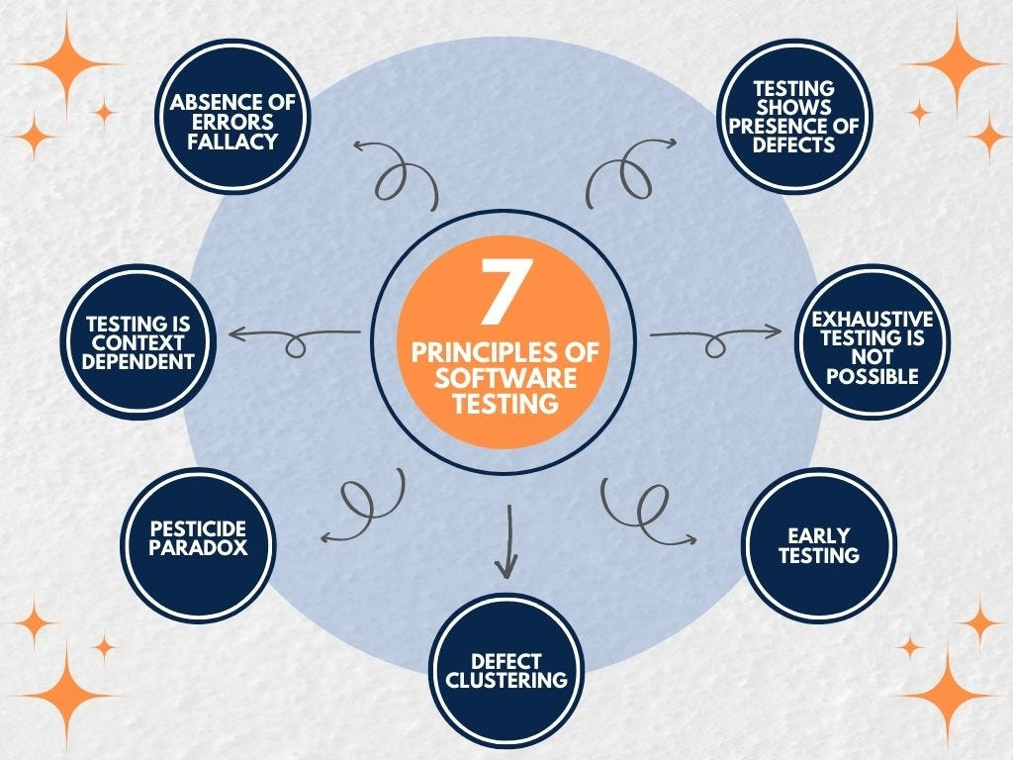
Principles of Software Testing

Slide 27
Principles of Software Testing
Software testing is an important activity. It provides certain level of confidence with the product. That level of confidence achieved through a series of testing activities. Software testing activities is a procedures that are executed to catch bugs, errors, defects as early as possible, ensure that the product meets acceptance criteria, and the completeness of specifications in accordance with business, user, and product requirements.
To run that procedures, we need to have a strategy, so our testing activities will not take too long time but still optimum enough to reach the goal.
How can we develop a good strategy? Or Base on what we develop that strategy? One of the rules that have been proven to be used as a basis for building strategy is 7 Principles Of Software Testing.

Slide 28
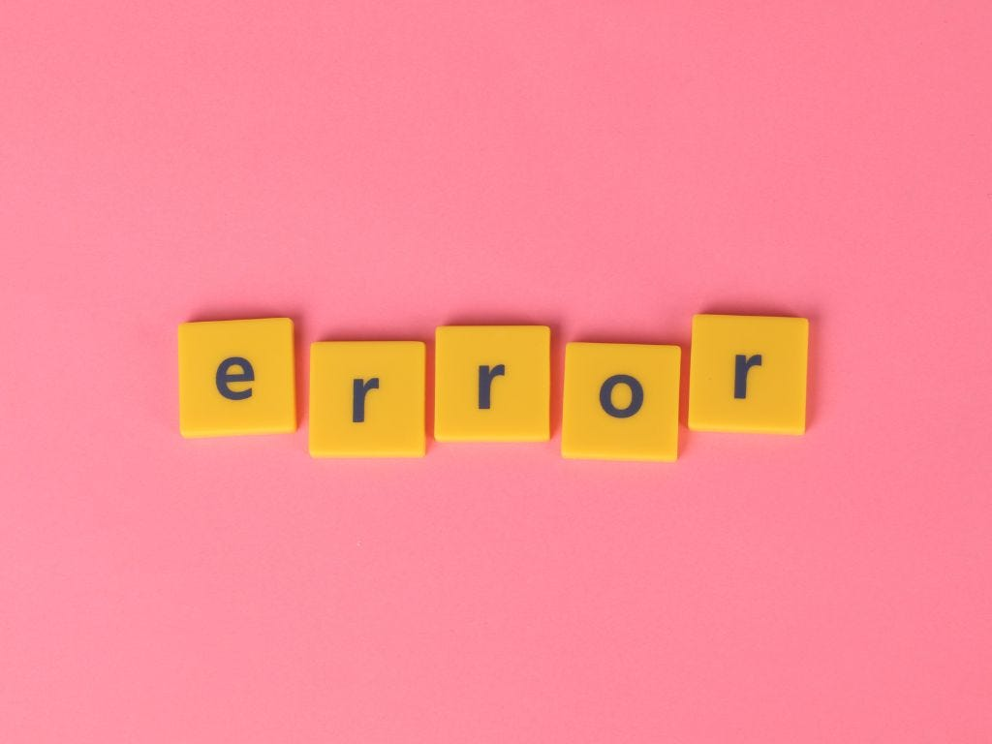
1. Testing shows presence of defects
The purpose of software testing is to reduce bugs occurrence in software using various methods and techniques. By doing series of testing procedures, it detect the presence of bugs or defects . Software testing can only ensure that bugs are present, not those that are absent. Even after we execute test endlessly, it is impossible to be sure that the software is completely bugs-free.
Presence of defects

Slide 29
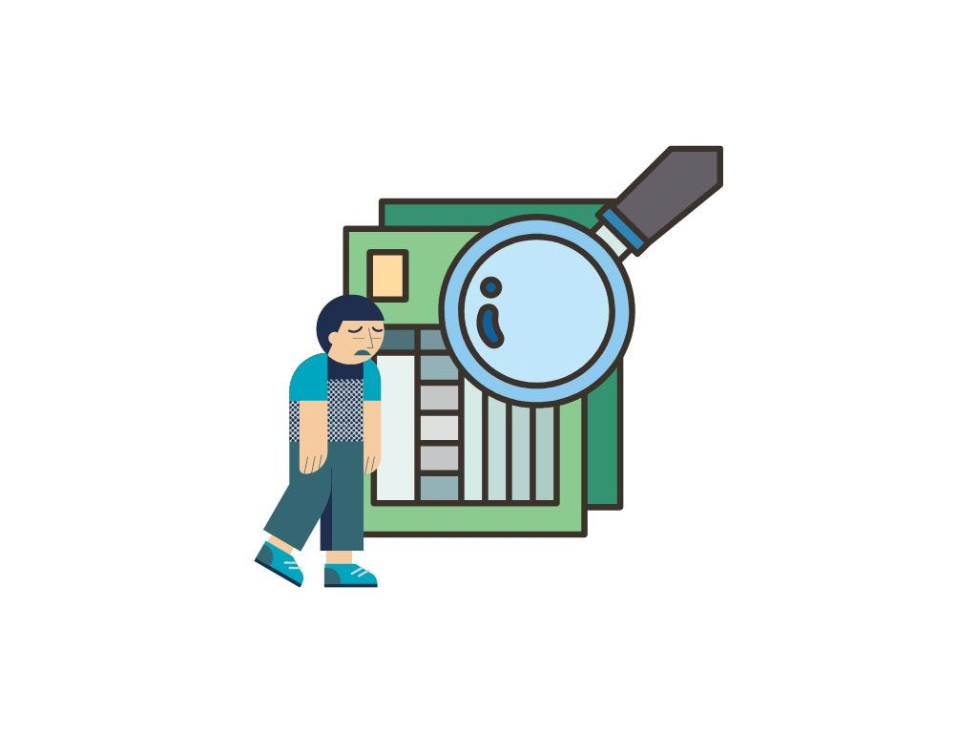
2. Exhaustive testing is not possible
It is a practice of testing a software using all possible inputs and preconditions. It is very difficult to test all modules and their functionality with valid and invalid combinations of input data throughout the testing process.
Imagine an input field that accept age information, we need to execute test using 1, 2, 3, 4, 5, and so on. And don’t forget to also test it using invalid value, such as a-z, A-Z. It is a very time-consuming procedure and very not cost effective.
Exhaustive testing

Slide 30

3. Early testing
Here early testing means that all the testing activities should start in the early stages of the software development life cycle's requirement analysis stage to identify the defects because if we find the bugs at an early stage, it will be fixed in the initial stage itself, which may cost us very less as compared to those which are identified in the future phase of the testing process.
To perform testing, we will require the requirement specification documents; therefore, if the requirements are defined incorrectly, then it can be fixed directly rather than fixing them in another stage, which could be the development phase.
Early testing

Slide 31

4. Defect clustering
The defect clustering defined that throughout the testing process, we can detect the numbers of bugs which are correlated to a small number of modules. We have various reasons for this, such as the modules could be complicated; the coding part may be complex, and so on.
These types of software or the application will follow the Pareto Principle, which states that we can identify that approx. Eighty percent of the complication is present in 20 percent of the modules. With the help of this, we can find the uncertain modules, but this method has its difficulties if the same tests are performing regularly, hence the same test will not able to identify the new defects.
Defect clustering

Slide 32
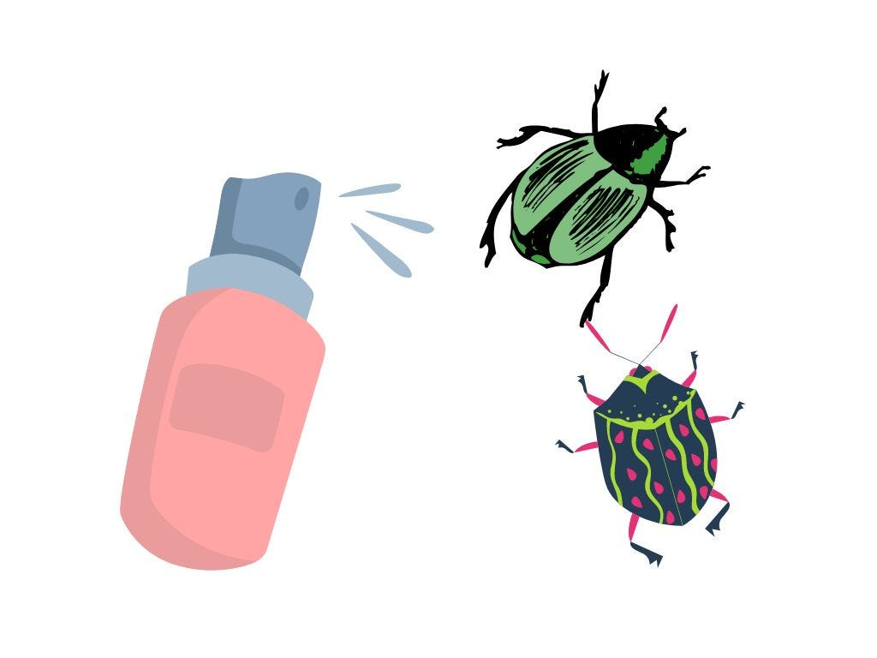
5. Pesticide paradox
Imagine a farmer that are using the same type and doses of pesticide to spray bugs, again and again repetitively, eventually bugs will develop immunity to that kind of pesticide. The same thing happened to software testing. If the same methods and approaches are used repetitively, the method will be useless to catch a new bugs.
To overcome this, the test case needs to be evaluated and replaced periodically. Also, tester need to be more creative and run the test outside the test case.
Pesticide paradox

Slide 33

6. Testing is context dependent
Testing is a context-dependent principle that states that we have multiple fields such as e-commerce websites, commercial websites, and so on are available in the market. There is a definite way to test the commercial site as well as the e-commerce websites because every application has its own needs, features, and functionality.
To check this type of application, we will take the help of various kinds of testing, different technique approaches, and multiple methods. Therefore, the testing depends on the context of the application.
Context dependent

Slide 34

7. Absence of errors fallacy
Once the application is completely tested and there are no bugs identified before the release, so we can say that the application is 99 percent bug-free.
But there is the chance when the application is tested beside the incorrect requirements, identified the flaws, and fixed them on a given period would not help as testing is done on the wrong specification, which does not apply to the client's requirements. The absence of error fallacy means identifying and fixing the bugs would not help if the application is impractical and not able to accomplish the client's requirements and needs.
Absence of errors fallacy

Slide 35
Basic Terminology in Software Testing
Here is the list of testing terminology-
Bug: An error in a software application that causes it to behave in an unintended manner.
Defect: An issue or bug identified during testing that needs to be fixed.
Error: A mistake made by a person while developing or using a software application that results
in an incorrect output.
  An incorrect internal state that is the manifestation of some fault. An error is an incorrect state within the software system that arises as a result of a fault. For instance, if a fault in the code leads to a variable being assigned an incorrect value, the incorrect value represents an error.
Fault - A static defect in a software system that may or may not cause an error.
  A fault represents an error or a flaw in the software code or its design. For example, a fault could be an incorrect calculation, a logical error in a conditional statement, or a missing validation check.
Failure - The inability of a software system to perform its intended function according to its specification.
  External, incorrect behaviour with respect to the requirements or another description of the expected behavior.
  A failure is when the software system exhibits behavior that deviates from its expected behavior as defined in the requirements or specifications. Failures are often observable by users or testers. For example, if a user clicks a button and the software crashes, that represents a failure.

Slide 36
Basic Terminology ….Contd…..
Test Case: A set of steps and expected results used to test a specific feature or functionality.
Test Suite: A collection of related test cases.
Test Script: A set of instructions used to execute a test case.
Test Execution: The process of running the test cases and recording the results.
Test Data: The inputs used to execute test cases.
Severity: The degree of impact a defect has on the software's functionality.
Priority: The level of importance assigned to a defect based on its severity and other factors.
Traceability: The ability to trace requirements to test cases and defects.
Test Environment: The hardware, software, and network setup used to conduct testing.
Test Coverage: The percentage of requirements or code covered by the test cases.
Test Automation - The process of using software tools to execute tests and compare results.
Test Scenario: A high-level description of a test case or group of test cases.
Test Plan: A document that outlines the testing approach, objectives, scope, and deliverables.
Test Report: A document that summarizes the testing results, including any defects found.

Slide 37
Software faults can lead to software errors.
Software errors, when triggered, can manifest as software failures.
Verification activities aim to detect software faults and prevent software errors.
Validation activities focus on ensuring that the software meets user requirements and prevents software failures.
Test cases are designed to identify software failures by testing specific scenarios.
Test suites are collections of test cases organized to test different aspects of the software.
Black-box and white-box testing techniques are employed to design effective test cases.

